Slide 1
About DevOps
dev+ops=profit!

Slide 2

No deployment at Friday 5:59:59pm!
Ops being a***** refused to deploy

Slide 3

AGAIN, WHAT ABOUT QA?????

Slide 4
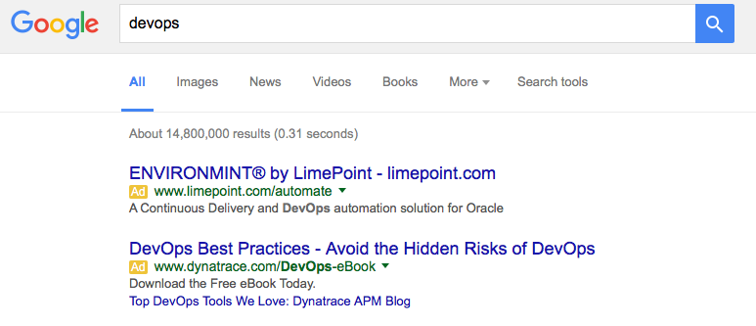
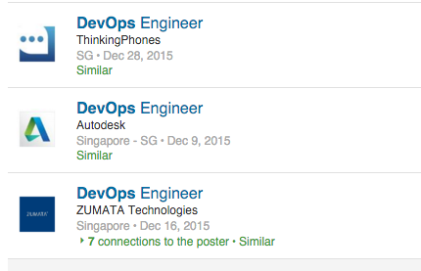
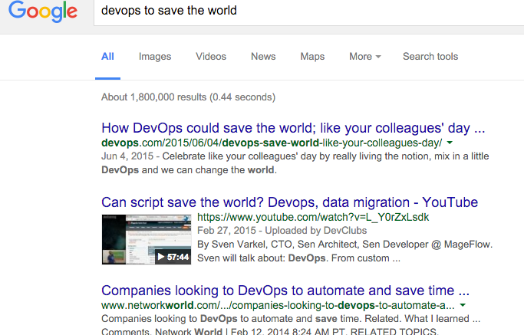
What is DevOps?
Software/Tools?
Job Title ?
Save the world?

Slide 5
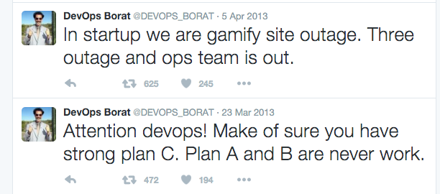
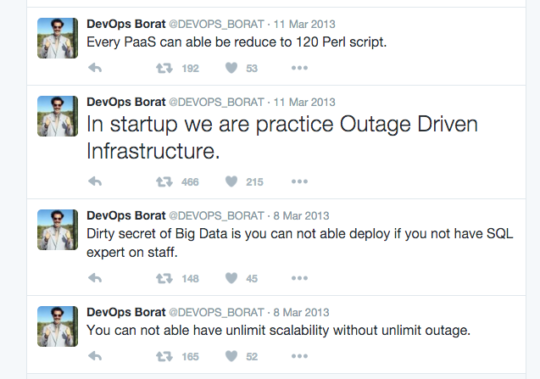
According to Borat, DevOps is...

Slide 6
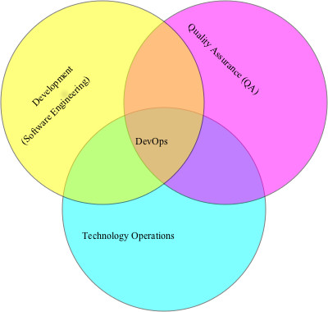
So, What is DevOps?
DevOps (a clipped compound of "development" and "operations") is a culture, movement or practice that emphasizes the collaboration and communication of both software developers and other information-technology (IT) professionals while automating the process of software delivery and infrastructure changes.
From Wikipedia, so must be correct!

Slide 7
Did you notice?
It is not just Dev + Ops!
QA is in the Venn Chart!
Yes, Quality Assurance is part of the DevOps equation!

Slide 8
Why DevOps?
Continuous Delivery = lots of deployment
Traditionally, lots of friction between Ops and Dev.
“Your code broke my production!”
“Your production broke my code!”
“Ops refuses to deploy…”
“Devs are being careless…”
…
Facebook used to say “Move fast and break things!”
Time to market matter in this era.
Move fast with automation, communication, and empathy!

Slide 9
Automation
Automation = predictibilty
Automation = faster/shorter turnaround
Automation = less error prone
Automation = faster for error to propagate
Automation = more effort up front
Automation = deep understanding on the system

Slide 10
What to automate?
Deployment
Setup
Regression test
Standard Error Recovery
Notification
Log collection/rotation
Security Scan
Monitoring

Slide 11
But before automate it,
Understand the system
Understand the code
Understand the business impact
Understand the business requirement
Understand the need for automation, not everything needed to be automated

Slide 12
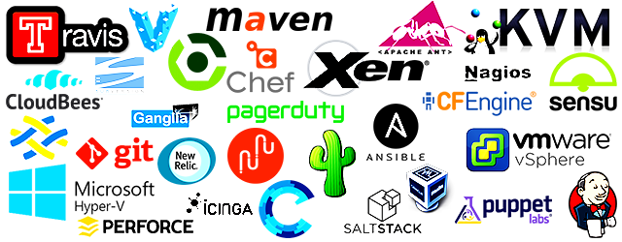
Automation tools

Slide 13
Best tool for automation is still
BASH + PERL/Python!

Slide 14
Why QA automation?
Imagine if the system can do deployment for every commit to the master branch!
Imagine if the regression test suite has 10000 test cases!
Imagine if you have team of 10 developers!
Imagine if your project milestone is measured in days!
Well, without Test Automation, your QA will hate you, really really hate you!

Slide 15
TDD/ATDD/BDD
Unit Tests to cover function consistency!
add(3,4) always return 7
Acceptance Tests to cover feature/function expectation!
Login page should always display login field and password field
Behavioural Tests to cover features flow consistency!
Login with correct user ID and password combination should allow user to login and redirect us to user landing page

Slide 16
TDD
Java: JUnit
PHP: PHPUnit
Javascript: Jasmine, QUnit
almost all popular programming languages have its own unit test framework(s)

Slide 17
BDD, Gherkin
Feature: Some terse yet descriptive text of what is desired In order to realize a named business value As an explicit system actor I want to gain some beneficial outcome which furthers the goal Scenario: Some determinable business situation Given some precondition And some other precondition When some action by the actor And some other action And yet another action Then some testable outcome is achieved And something else we can check happens too Scenario: A different situation ...

Slide 18
Test Automation
Jenkins + Selenium
Multiple parallel execution
using cloud to dynamically scale out test executions
JBehave + Selenium

Slide 19
Why test automation
Would you have sex 5 times a day with random stranger without condom?
Would you do 5 deployments a day with random code change without test automation?

Slide 20
Deployment Automation
Git, do you know git enough?
Jenkins/Bamboo
CircleCI, Travis, or millions of CD SAAS wannabe.
Chef/Puppet/Ansible/… for system management
Or using ssh+bash/perl/Python/nodejs

Slide 21
Monitoring
Nagios, Monit, Pingdom, …
You don’t want to be the last one to know production is down, trust me, you don’t!
Pager Duty, Ops Genie for alert escalation
have a good escalation policy
Logstash, Fluentd, Apache Flume, scribe, or rsyslogd
Log everything… disk is cheaper than your hours of debugging
disk space concern? Logrotate to the rescue!
New Relic, Data Dog, Cloud Watch
RRD, Kibana, or many other Dashboard tools out there
A picture worth a thousand words

Slide 22
System
Package management: YUM, Apt-get
htop!
VIRT vs RES vs SHR
service, systemctl, /etc/init.d
iostat
netstat
sed, awk, cut, grep/egrep, sort, uniq, head, tail, more, less, find, uname, wget, curl, sudo, dmesg, netcat, ssh, scp, ps, lsof, tar, gzip, touch, which, echo, cat, chmod, chown, chgrp, bash, w, uptime, man
VIM, emacs, nano, pico

Slide 23
What about Docker?
Not enough hand-on experience to comment
Virtualbox works for me, so I am sticking with it. Vagrant is good if you want to have tool to manage your virtualbox VMs.
Why docker? light weight and simple setup to have production quality setup on your computer.

Slide 24
Network
PING!
But Ping is so old school, use mtr!
telnet!
Challange: can you fetch google homepage using telnet??
telnet is very useful for connectivity check
how to tell the differences between firewall blocking and no app/service listening to the port?
Wireshark, extremely powerful, also extreme complex
Nginx (not just a web server…)
what else can you use Nginx for?

Slide 25
Security
XSS Scanner: OWASP Xenotix, w3af
SSH!!!!!!
SELinux
Sudo, no one login as root
Suricata, Kismet, etc for IDS
Check and read OWASP!!!!

Slide 26
So What is DevOps?
Tools?
Automation?
Test? TDD? BDD?
Jenkins?
Chef, Puppet?
AWS?
Monitoring? Alert? Dashboard?
Security?
CI/CD?
Probably a bit of everything

Slide 27
DevOps is
Empathy
Communication
Ownership
Responsibility
Progressive
Quality
don’t be an asshole…
helping the team
about let’s work together to deliver good software!

Slide 28
DevOps is not
about tools… all the greatest tools in the world, still no one want to work with an asshole
about CI/CD… deliver a broken software is not DevOps
about automation… automated error delivery system is not DevOps
about monitoring… that poor guy can’t click on a button on a webpage really doesn’t care if you get paged in the middle of night, he just wants to click to go to the next page!
about agile, but it does work well with Agile Manifesto
QA replacement
Ops replacement

Slide 29
Disclaimer
All slides before are strictly IMHO.. :) Enjoy coding, testing, deploying and all the midnight calls! When in doubt, ask Google…
Oh, Windows, what about windows? Please ask Weihan… LOL

